Slide 1
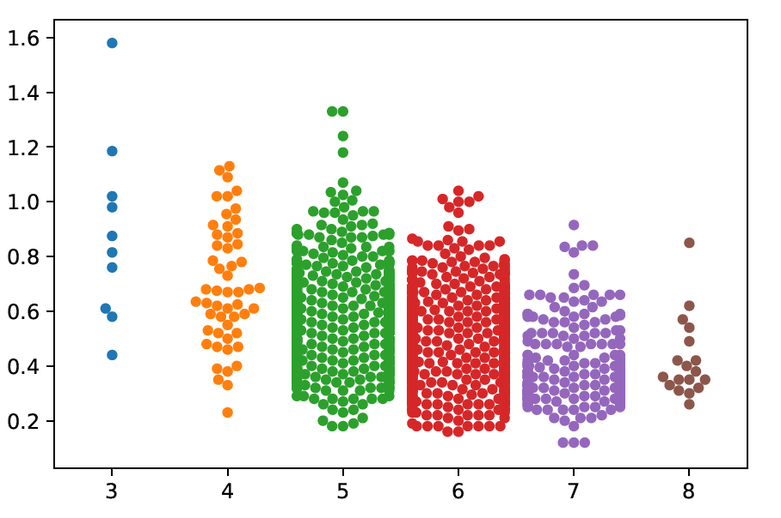
IBM Machine Learning Professional Certificate
Online Course Recommendation Model
Shankesh Raju MS

Slide 2
Outline
Introduction
Exploratory Data Analysis
Word cloud
Content - based Recommendation using user profile and genre
Content - based Recommendation using clusters
KNN - based collaborative filtering
NMF - based collaborative filtering
Neural Network embedding based on collaborative filtering
Performance Comparison
Conclusion

Slide 3
Introduction
About
Recommendation system for online courses
Model recommends new courses based on different criterias
Recommendations are generated based on user interest, course similarity in same group
Implementation
using unsupervised learning
using supervised learning

Slide 4
Exploratory Data Analysis

Slide 5
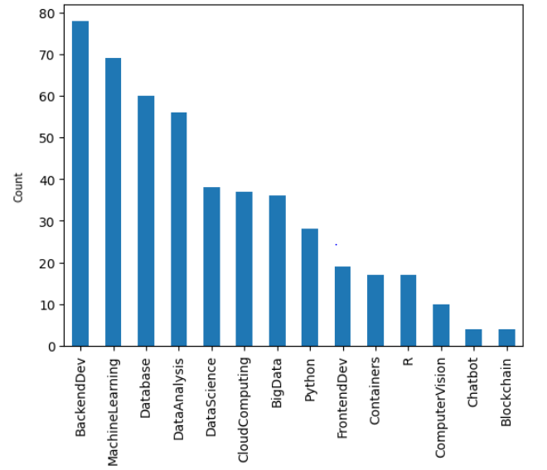
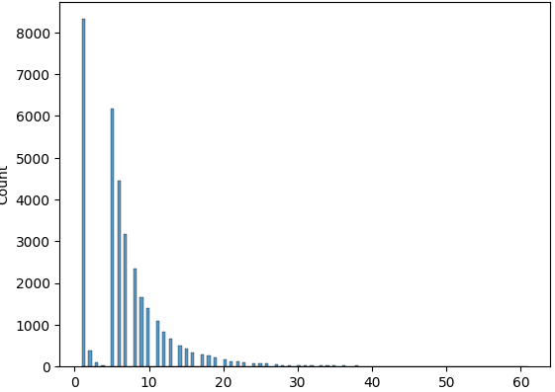
Course Enrollment and Genre Distribution

Slide 6
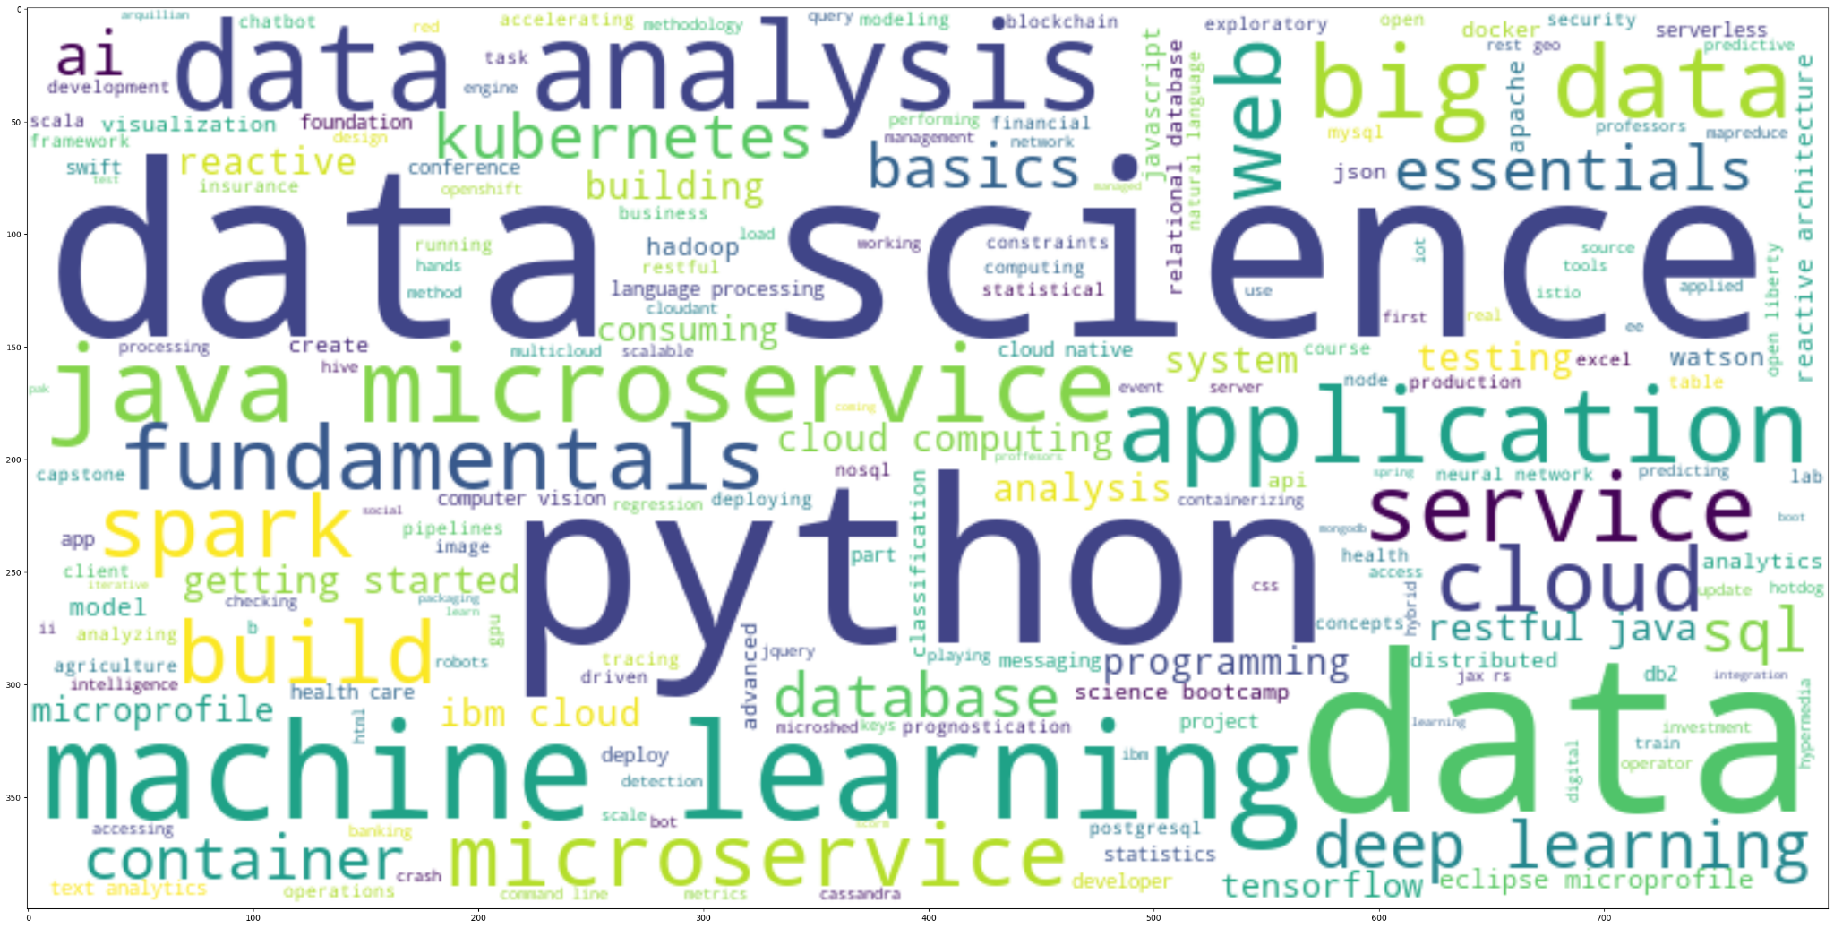
Word Cloud Titles

Slide 7
Content-based Recommender System
User Profile and Genre

Slide 8
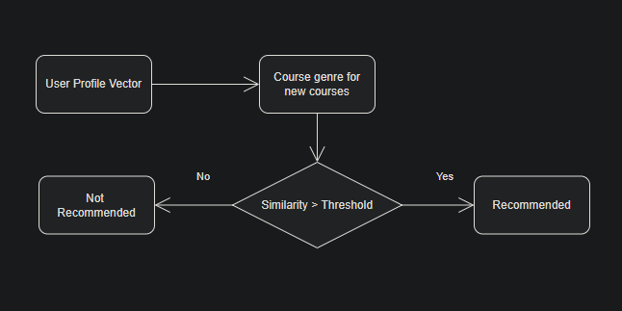
Flowchart Implementation

Slide 9



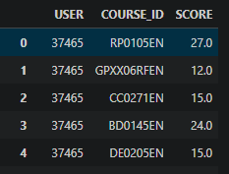
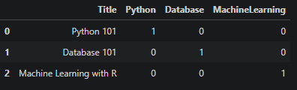
Real-Time Implementation
Creation of simple user rating Data Frame
Generation of user profiles
Generation of recommended scores
Top 5 Recommendations

Slide 10
Content-based Recommender System
Course Similarity

Slide 11
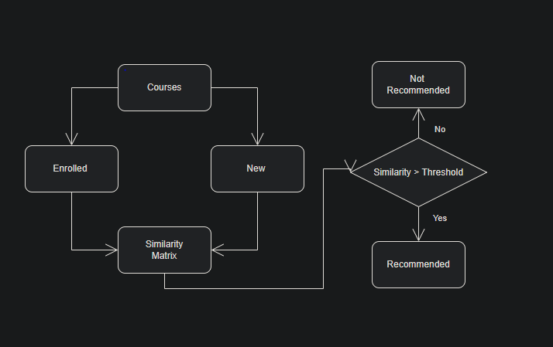
Flowchart Implementation

Slide 12
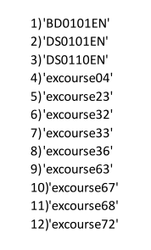
Evaluation
Score Threshold = 0.73
On average, 12 new/unseen courses are recommended per user

Slide 13
Content-based Recommender System
User Profile Clustering

Slide 14
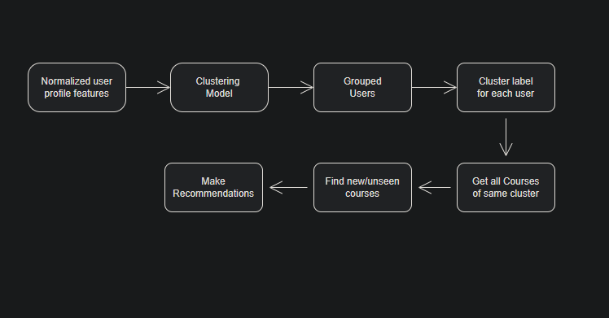
Flowchart Implementation

Slide 15
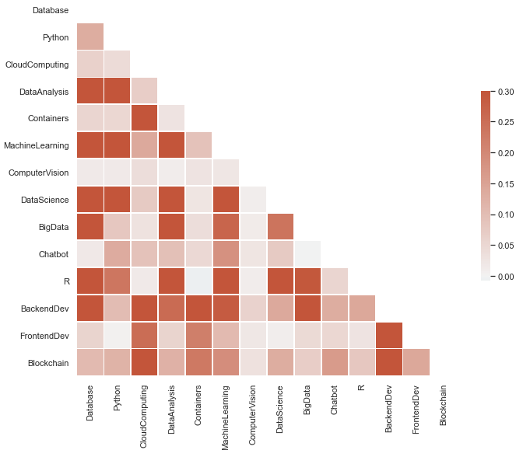
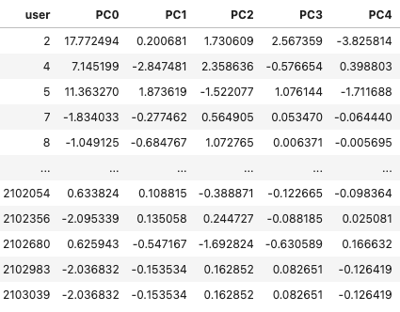
Applying PCA on user profile to reduce dimensionality

Slide 16
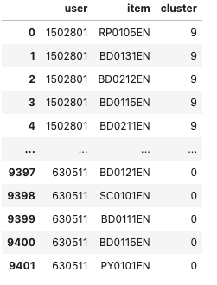
Evaluation
Average recommended courses per user is 2.33
The top-2 recommended courses are
Course 3 - Twice
Course 4 - Twice

Slide 17
KNN-Based Collaborative Filtering

Slide 18

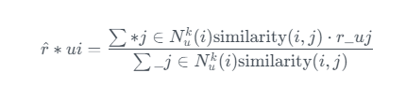
Implementation
Collaborative filtering is probably the most commonly used recommendation algorithm, there are two main types of methods
User-based collaborative filtering is based on the user similarity or neighborhood
Item-based collaborative filtering is based on similarity among items

Slide 19
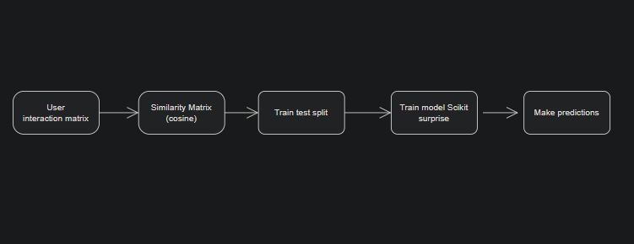
Flowchart Implementation

Slide 20
NMF-Based Collaborative Filtering

Slide 21
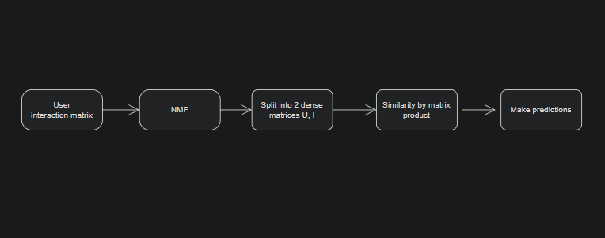
Flowchart Implementation

Slide 22
Neural Network Embedding - Based
Collaborative Filtering

Slide 23
Implementation
With explicit features vectors, we can perform machine learning tasks such as calculating the similarities among users or items, finding nearest neighbors, and using dot-product to estimate a rating value.
The main advantage of using these explicit features is they are highly interpretable and yield very good performance as well. The main disadvantage is we need to spend quite some effort to build and store them
Non-negative Matrix Factorization decomposes the user-item interaction matrix into user matrix and item matrix, which contain the latent features of users and items and you can simply dot-product them to get an estimated rating

Slide 24
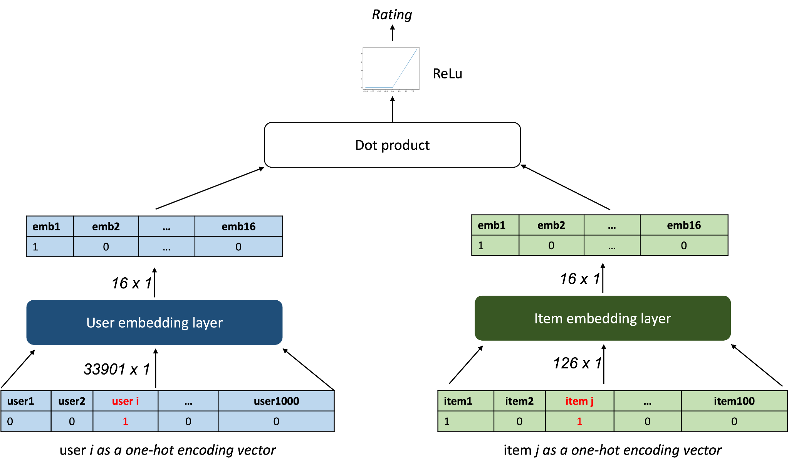
Rating Implementation

Slide 25
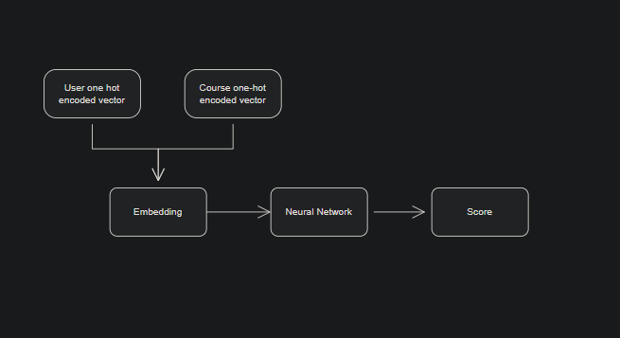
Flowchart Implementation

Slide 26
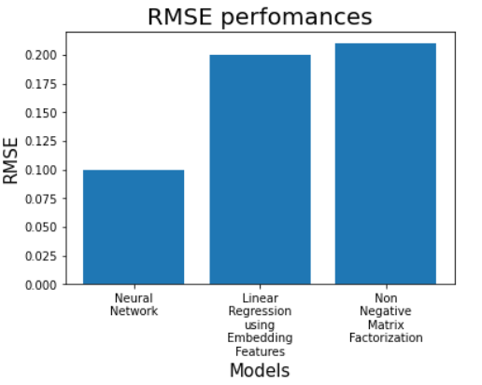
Algorithm Evaluation

Slide 27
Appendixes
https://github.com/sabhashanki
https://www.codechef.com/users/androshanki

